Slide 1
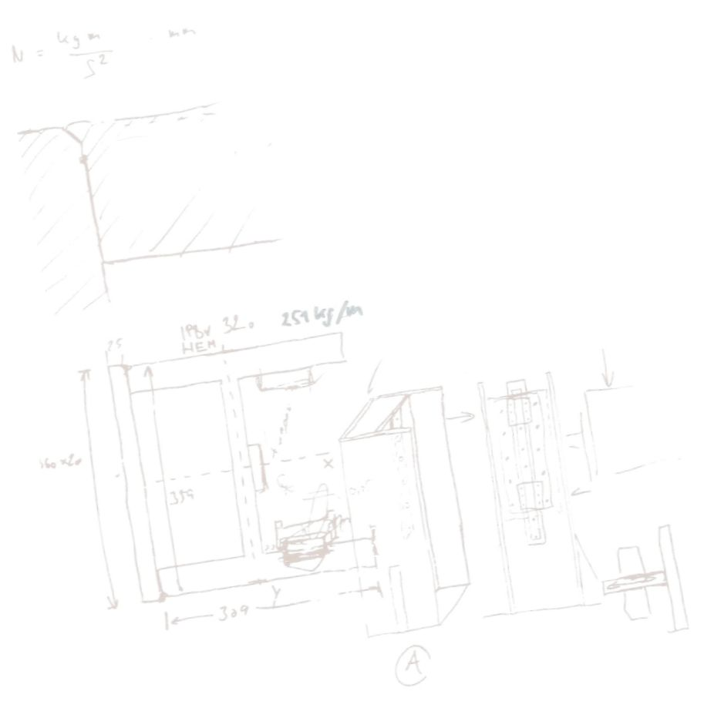
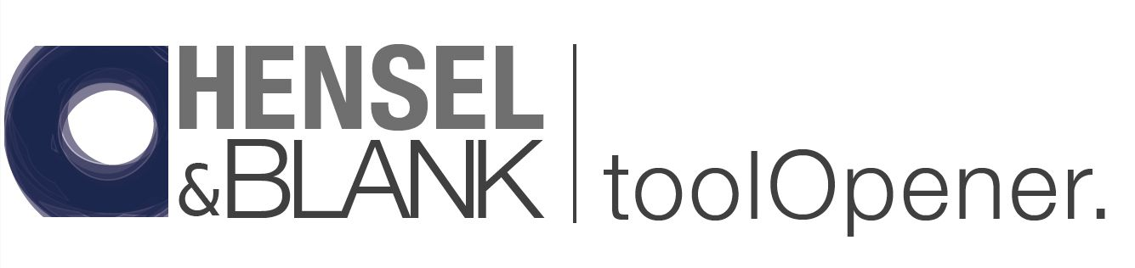



Safe, quick and efficient
handling and opening of punching and forming tools
German design + Indian creative power
with no compromise on quality
81
© Copyright Hensel & Blank, 2022. All rights reserved. Reprint, also in parts, is only permitted with the approval of Hensel & Blank GmbH
Notes:
The founders of Hensel & Blank GmbH have been involved in optimizing punching technology for more than 30 years.
Many projects have been successfully implemented to increase quality and reduce costs.

Slide 2


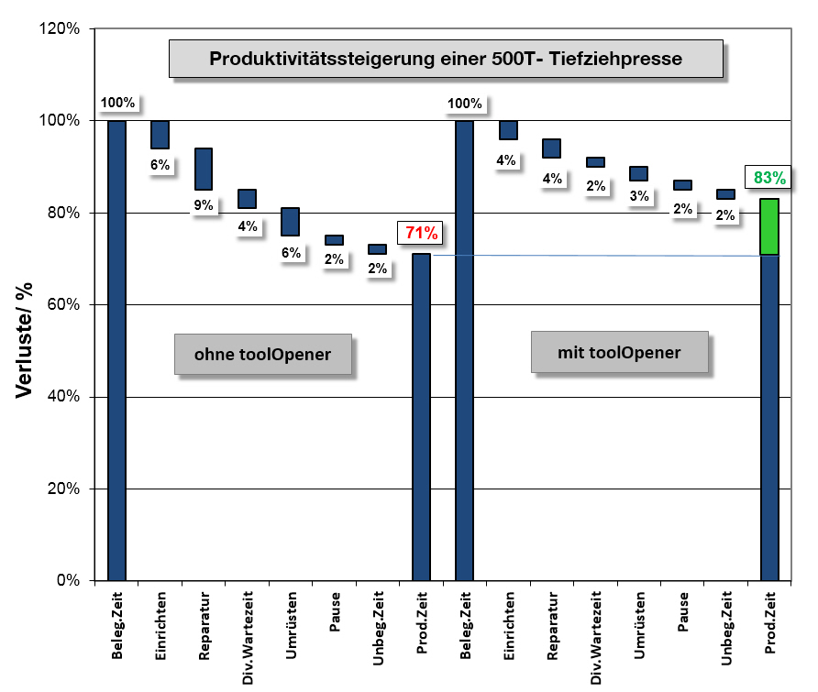
During a Six Sigma (6σ)- project in our stamping shop we analyzed:
120
Production increase of a 500T press
The typical losses for a press process due to setting up, retooling and repair work of 20% to 30% can be reduced by more than 10% using our tool opener
The waterfall diagram shows the increase in production by reducing unproductive times, such as repairs and retooling
Time in %
Without toolOpener
With toolOpener
The diagram does not take into account the effects of industrial accidents on traditional tool handling.
Losses
Losses
Break
Idle time
Break
Idle time
Repair time
Set up time
Repair time
Adaption time
Productive time
Set up time
Adaption time
Productive time
Occupation time
Var. waiting times
Occupation time
Var. waiting times

Slide 3
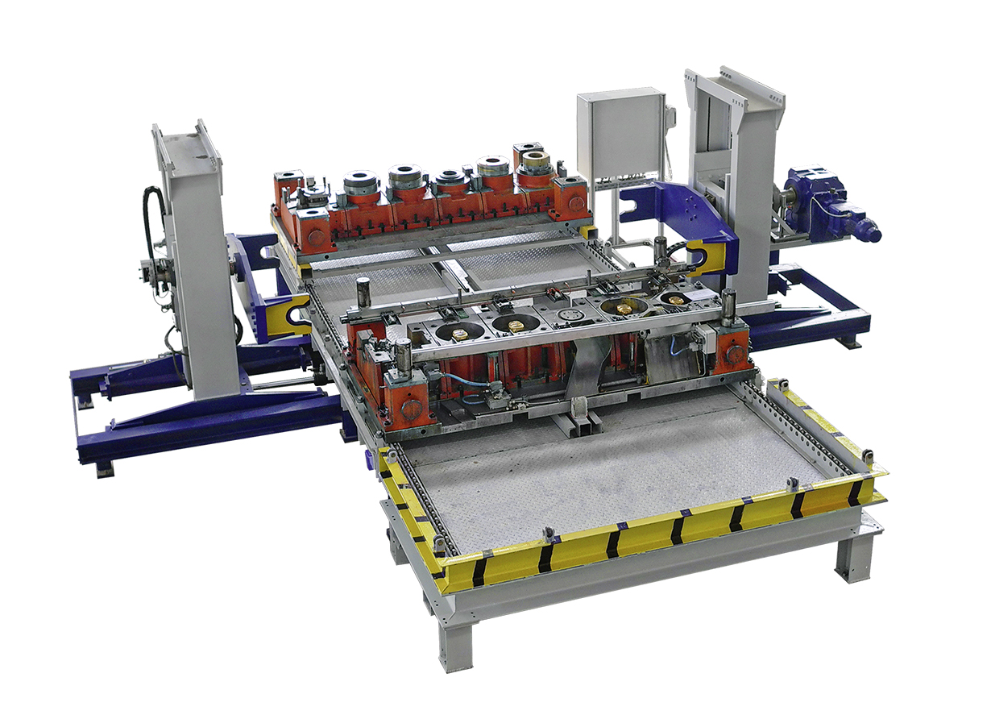
Example 1:
toolOpener tO10.0s
Tool weight: 10.000 kg
Tool dimensions: 2.500 x 1.200 x 850 mm
the toolOpener was the Score of our Six Sigma (6σ)- project in the toolshop
the toolOpener is our solution for the safe and economical handling of punching and drawing tools.
the toolOpener takes on the task of separating the upper part of the tool from the lower part and turning and storing it according to the requirements of the specialist staff and thus making it available for all work on the tool.
the advantages are:
Increase the OEE (Overall Equipment Effectiveness)
Increase the OTIF (On Time in Full) that means complete and timely delivery
Improve work safety
Improve quality of work
The first prototype was launched in 2007 and has since been continuously optimized

Slide 4
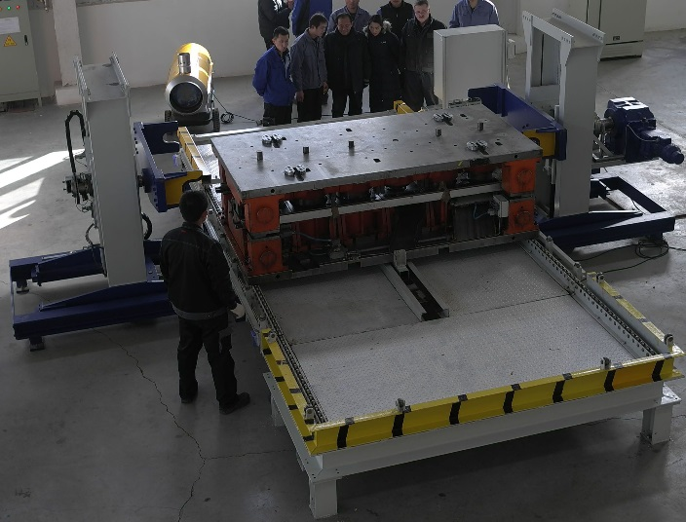
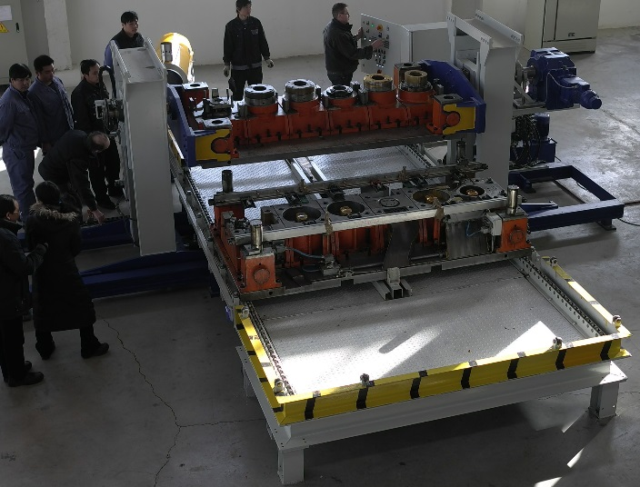
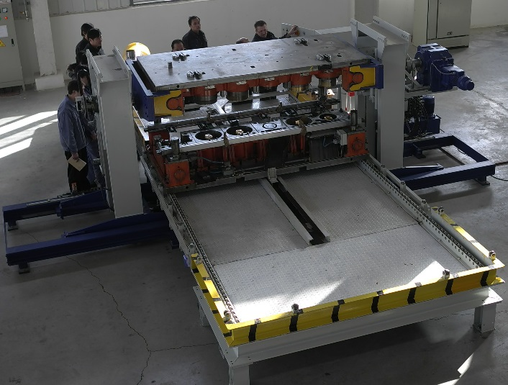
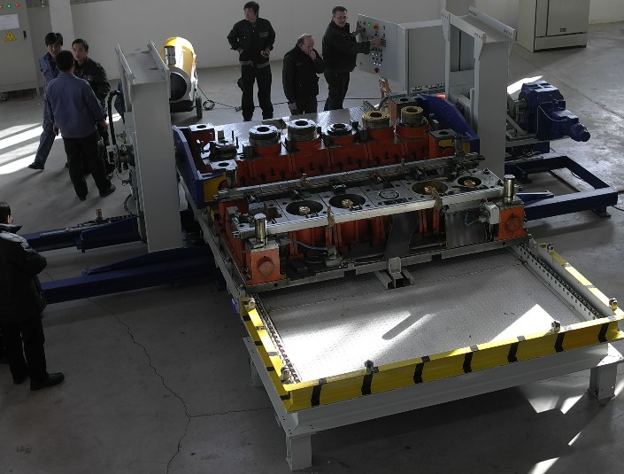
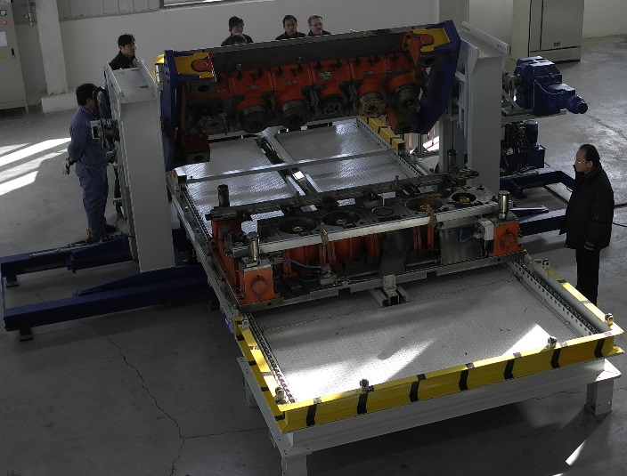
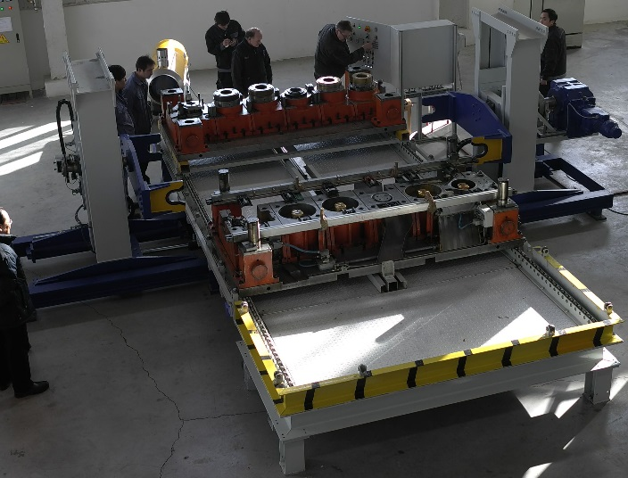
Experts from production and maintenance played a key role in the development of the tool opener. The result is a sophisticated concept that can be tailored precisely to the needs of the operator.
The toolOpener takes over fully automatically, safely and efficiently in a fraction of time, which previously had to be carried out with great expenditure of time and a high level of personnel using forklifts and crane systems with a high safety risk.
excellence in toolshop means:
absolute plane parallelism
infinitely variable drive
results in
finest tuning work
and highest quality
1
4
2
5
Work accidents and tool damage are a thing of the past with the toolOpener !
3
3
6
6

Slide 5
Manually handling the tools outside the press, using a crane or forklift truck, usually takes 30 to 120 minutes to deploy at least two to three skilled workers.
The toolOpener takes care of this in minutes, in the fully automated version even without personnel.
Economical of the toolOpener- benefits can be seen in the table
The payback period for the projects already carried out in Europe was less than 1.5 years.
Conservatively calculated, we expect an ROI in India of less than or equal to 2 years.
On request, we will send you the calculation table as an Excel file. Please send an E-mail to info@henselundblank.de

Slide 6
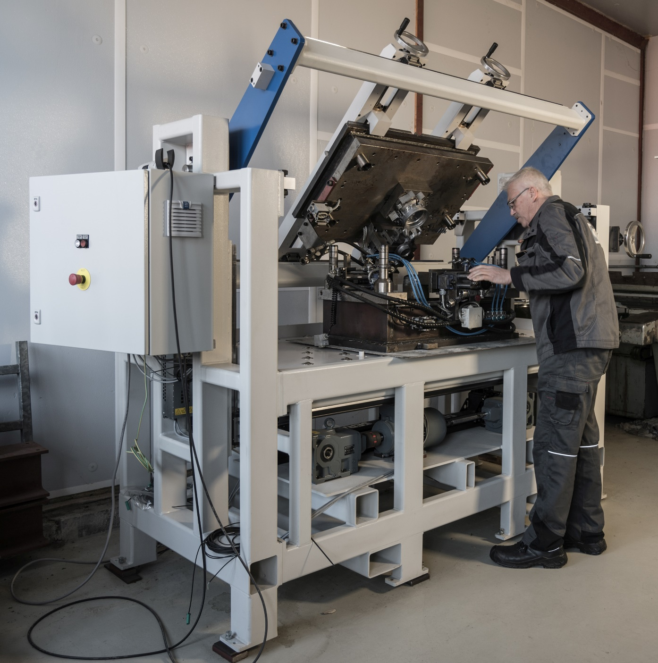

Example 2: the toolOpener tO02.0
Modular concept to accommodate a wide variety of punching, forming and injection molding tools.
Robust drive concepts with the highest precision.
Tools can be easily clamped and joined again after separating the lower and upper part. This opens up completely new possibilities for users and is unique so far.
State-of-the-art control concepts are available in different configurations (Industry 4.0 capable).
The development of these toolOpeners was supported by the central innovation program for medium-sized companies.
toolOpener tO02.0s
Tool weight: bis 2.500 kg
WZ- dimensions: bis 1.800 x 1.000 x 700 mm

Slide 7
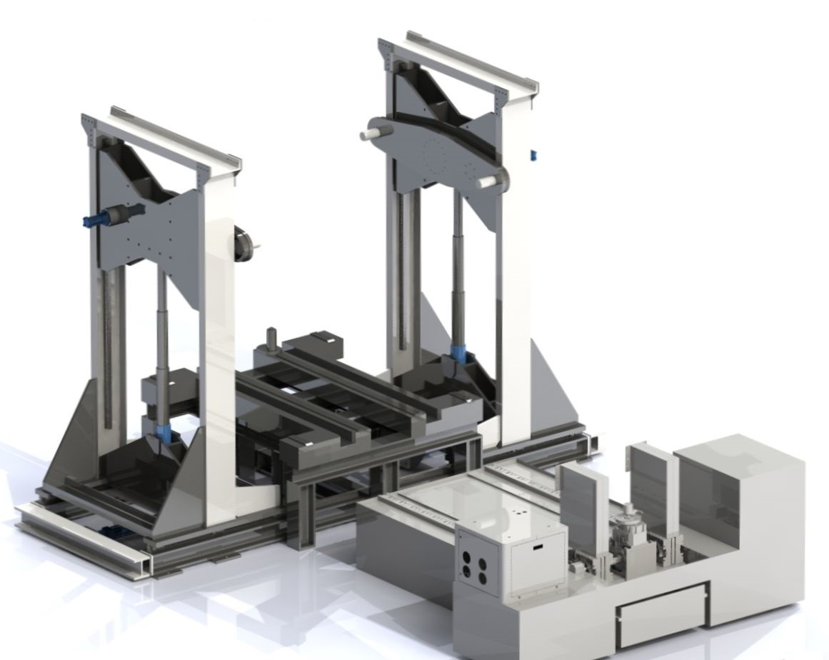
Example 3: the toolOpener 40th_green line
Stationary tool handling system for holding different sized punching and forming tools.
There are 3 tool positions defined:
Storage position tool upper part
Transfer and storage position tool lower part
opening position
Loading and unloading possible using crane and tool changing trolleys
The side stands of the lifting unit move symmetrically and are hydraulically driven.
The precision-guided lifting boxes are also driven hydraulically with position control. Energy recovery during the downward movement
The cross-bearing rotating unit is driven by a hydraulic motor and can be freely rotated through 360 °.
Control: Siemens SIMATIC S7 and SIMATIC Touch Panel
Industry 4.0 capable.

Slide 8
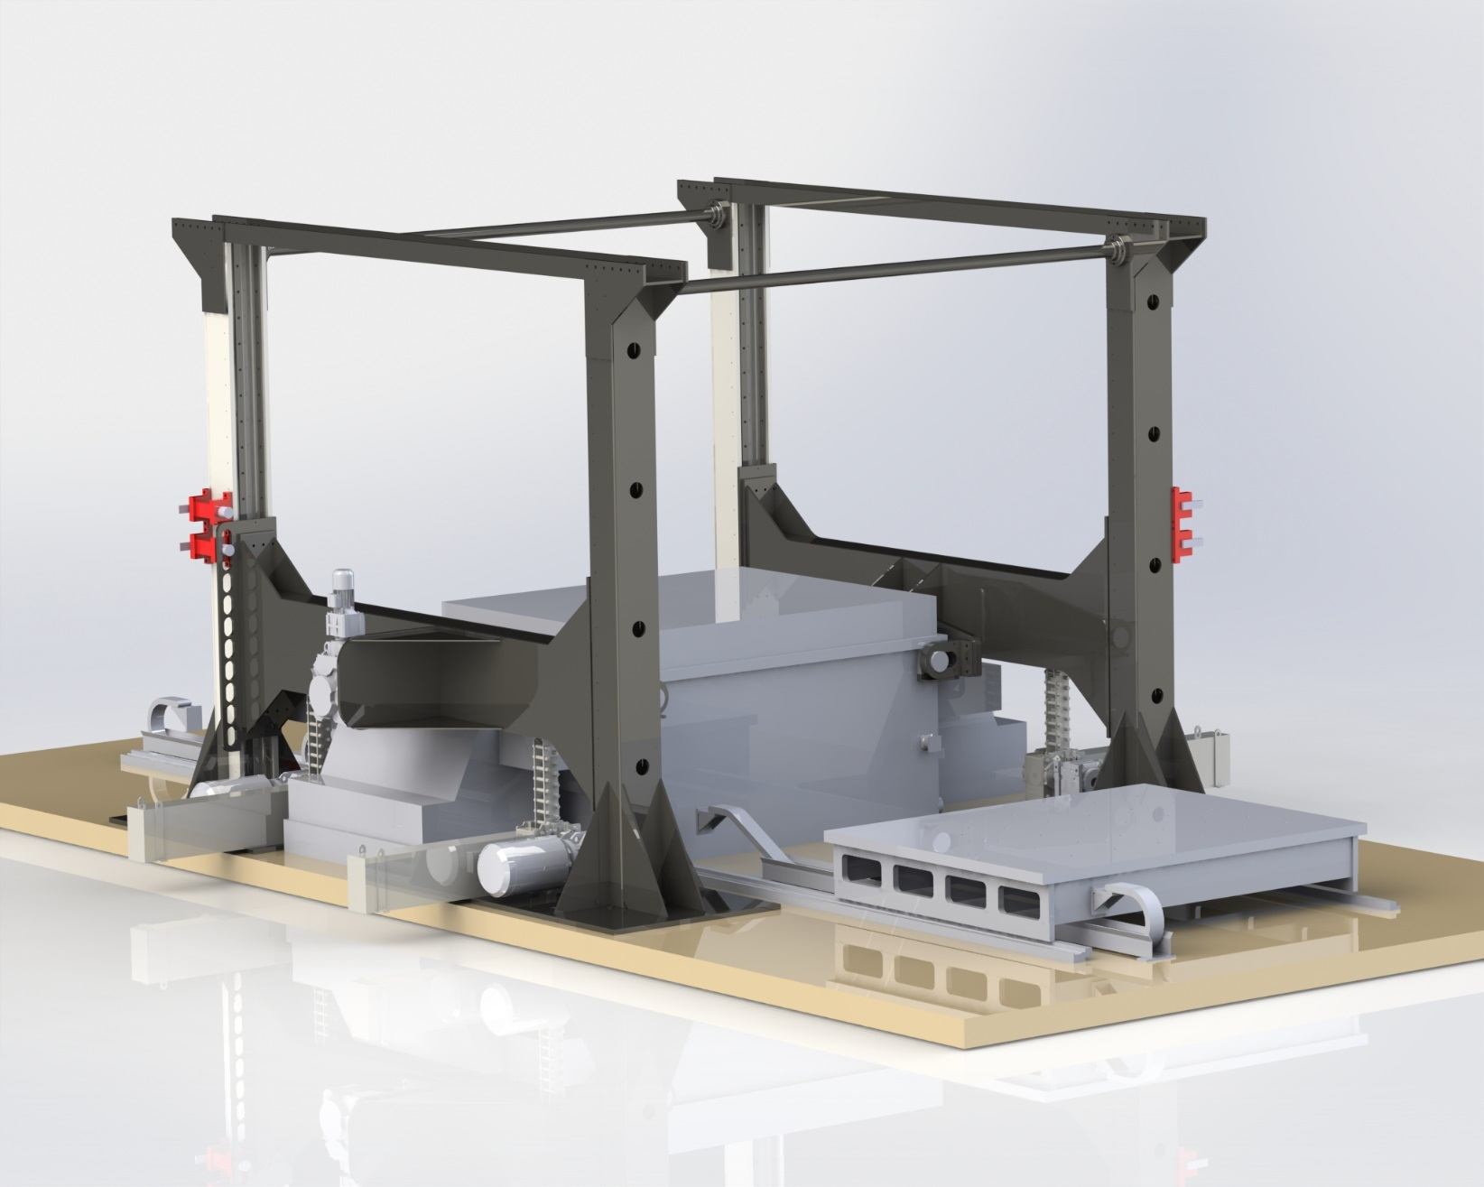
Example 4: the toolOpener tO60.0hs
A try-out plant for injection molding
with lifting speed of more than 100 mm/sec
Discover advantages:
Different tool sizes and designs can be opened with one and the same toolOpener.
Tools that have been pulled apart can be removed and loaded and joined at a later point in time.
Access to the upper part of the tool is guaranteed from both sides.
Also particularly suitable as a try-out system for injection molding tools
We offer a practice-oriented and company-specific concept - from the specification to successful commissioning.
toolOpener tO60.0hs
Tool weight: 60.000 kg
WZ- dimensions: 3.000 x 2.600 x 1.600 mm

Slide 9
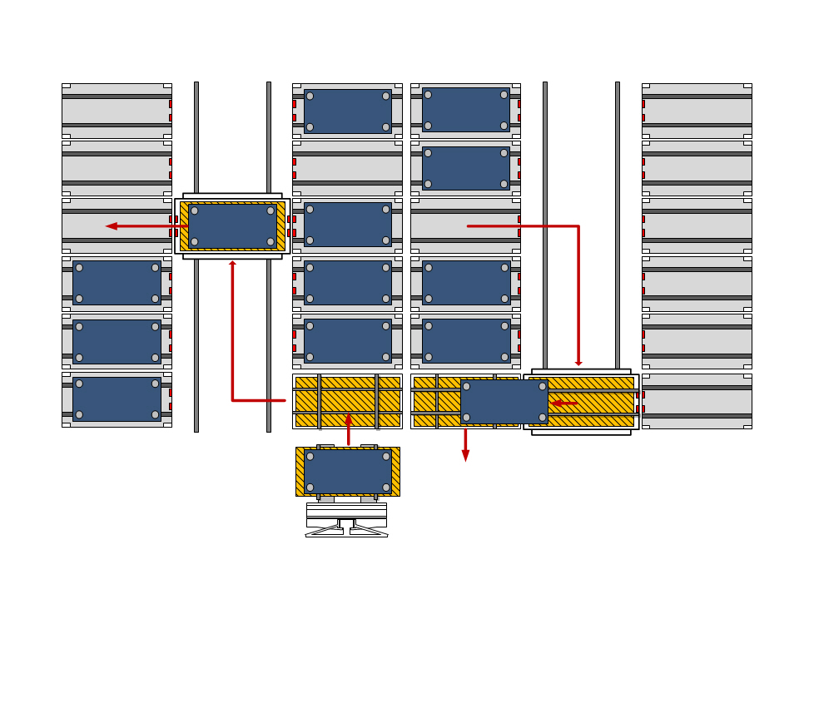
toolManager 4x18-10.0T0
Tool management systems for the storage and provision of punching and forming tools
Proper storage in a confined space
Modularly expandable - one storage module for each tool
The tool change can be automated with the appropriate interfaces to the tool changing carriage and to the press control.
Intelligent storage of the tools (depending on the frequency of use) saves time and resources.
Minimize set-up times in a confined space with the toolManager.
Any questions from your side ?
please do not hesitate to contact us
toolManager 4 x 18- 10.0To

Slide 10


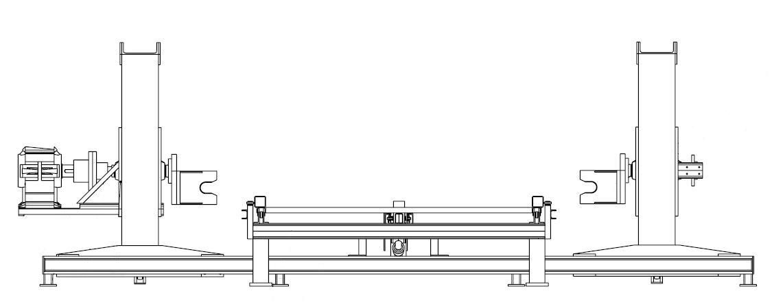

Please contact: Hensel & Blank GmbH • C/o IGEP Consult Pvt. Ltd.
The Peach Tree Complex, #102, Block – C, Sushant Lok, Phase – 1, Sector 43, Gurgaon-122002, Haryana, India
Phone: +91 (0)124 4048273 / 77 • Email: info@igep.org

