Slide 1
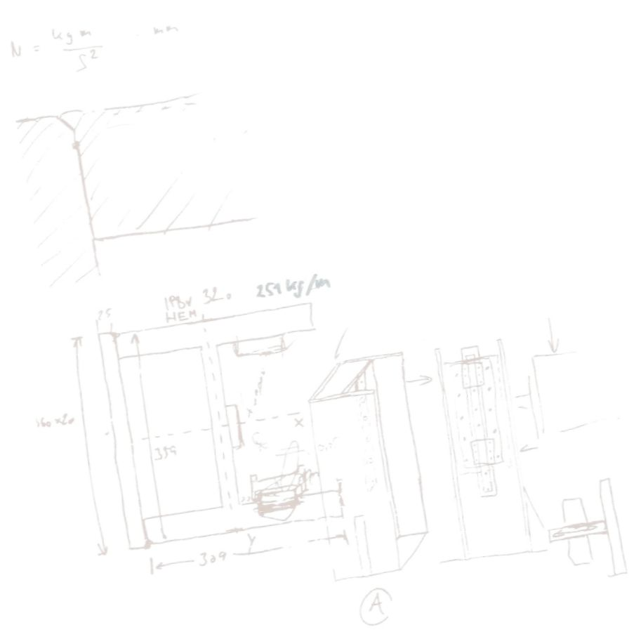
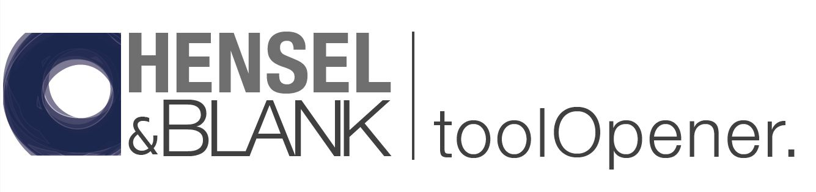



Safe, quick and efficient
handling and opening of punching and forming tools
German design + Indian creative power with no compromise on quality
81
© Copyright Hensel & Blank, 2022. All rights reserved. Reprint, also in parts, is only permitted with the approval of Hensel & Blank GmbH
Notes:
The founders of Hensel & Blank GmbH have been involved in optimizing punching technology for more than 30 years.
Many projects have been successfully implemented to increase quality and reduce costs.

Slide 2


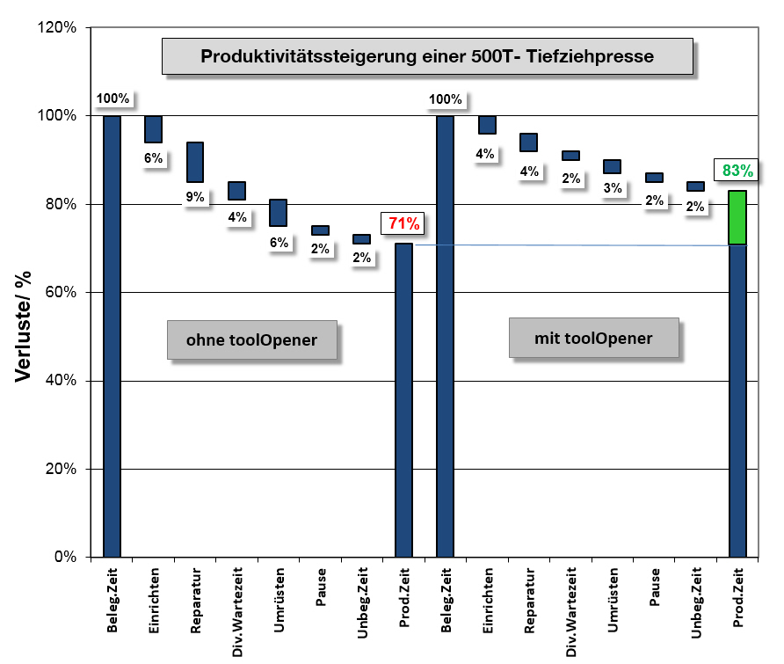
120
During a Six Sigma (6σ)- project in our stamping shop we analyzed:
Production increase of a 500T press
The typical losses for a press process due to setting up, retooling and repair work of 20% to 30% can be reduced by more than 10% using our tool opener
The waterfall diagram shows the increase in production by reducing unproductive times, such as repairs and retooling
Time in %
Without toolOpener
With toolOpener
Losses
Losses
Break
Idle time
Break
Idle time
Repair time
Set up time
Repair time
Adaption time
Productive time
Set up time
Adaption time
Productive time
Occupation time
Var. waiting times
Occupation time
Var. waiting times
Notes:
In the course of a six sigma project in our stamping shop years ago, many losses were discovered.
The biggest losses occurred during the handling, rebuilding or repair of the molds.
There was also repeated damage to tools while opening the tools with cranes, etc.
There were also frequent accidents at work.
This waterfall diagram shows the increase in productive time of a 8 step- deep- drawing process by using a toolOpener. The tool weight here is 10 tons.

Slide 3
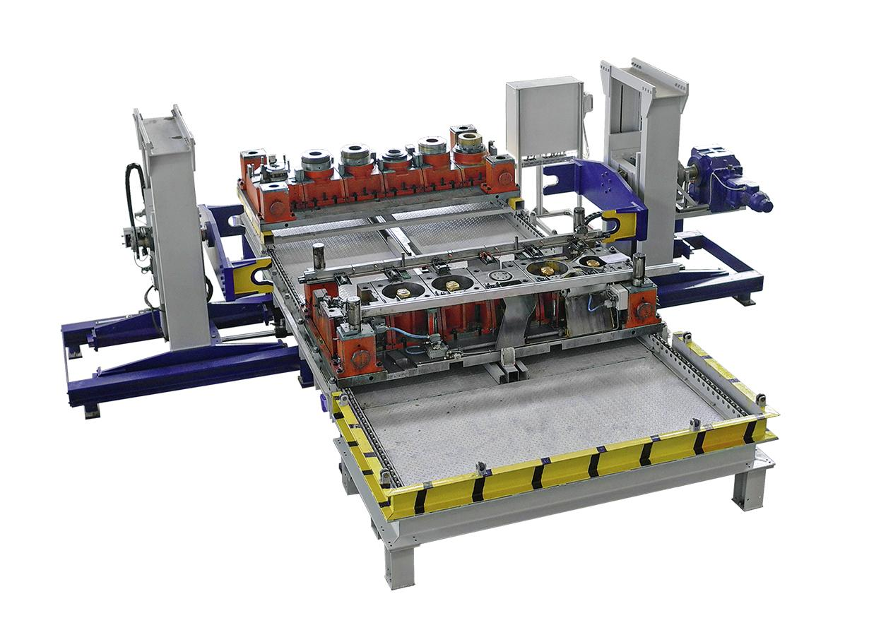
toolOpener tO10.0s
Tool weight: 10.000 kg
Tool dimensions: 2.500 x 1.200 x 850 mm
the toolOpener© was the Score of our Six Sigma (6σ)- project in the toolshop
Increase the OEE (Overall Equipment Effectiveness)
Increase the OTIF (On Time in Full) that means complete and timely delivery
Improve the work safety
Improve the quality of work
The first prototype was launched in 2007 and has since been continuously optimized
Notes:
The toolOpener was our solution for the safe and economical handling of punching and drawing tools.
The toolOpener takes on the task of separating the upper part of the tool from the lower part and turning and storing it according to the requirements of the specialist staff and thus making it available for all work on the tool.
After the completion of the prototype in 2007, the machine was used with great efficiency and continuously developed and improved.

Slide 4
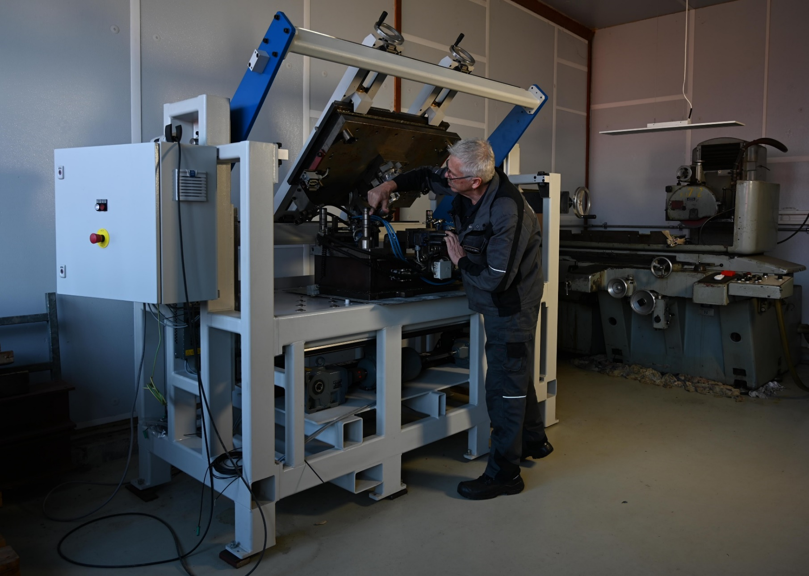
absolute plane parallelism
infinitely variable drive
results in
finest tuning work
and highest quality
Work accidents and tool damage are a thing of the past with the toolOpener !
toolOpener tO01.5LL
Tool weight: bis 1.500 kg
WZ- dimensions: bis 1.800 x 900 x 800 mm
3
6
Notes:
The toolOpener was developed, designed and built by designers and specialists from production and maintenance.
The toolOpener takes over fully automatically, safely and efficiently in a fraction of time, which previously had to be carried out with great expenditure of time and a high level of personnel using forklifts and crane systems with a high safety risk.
The accessibility of the upper part of the tool is guaranteed in every position.

Slide 5
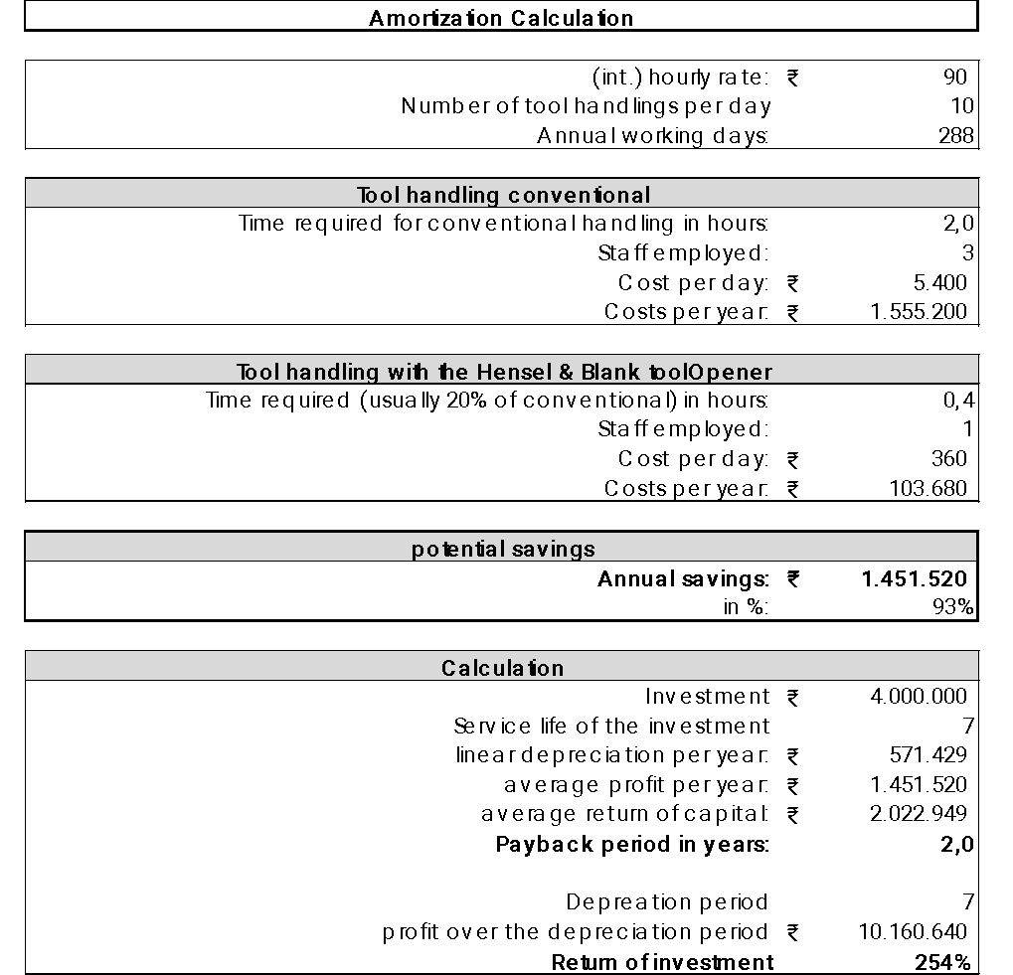
Our principle:
German design + Indian creative power with no compromise on quality
Economical of the toolOpener- benefits can be seen in the table
Conservatively, we expect an ROI in India of less than or equal to 2 years.
Notes:
Manually handling the tools outside the press, using a crane or forklift truck, usually takes 30 to 120 minutes to deploy at least two to three skilled workers.
The toolOpener takes care of this in minutes, in the fully automated version even without personnel.
The payback period for the projects already carried out in Europe was less than 1 year.
Conservatively calculated, we expect an ROI in India of less than or equal to 2 years.
On request, we will send you the calculation table as an Excel file. Please send an E-mail to info@henselundblank.de

Slide 6
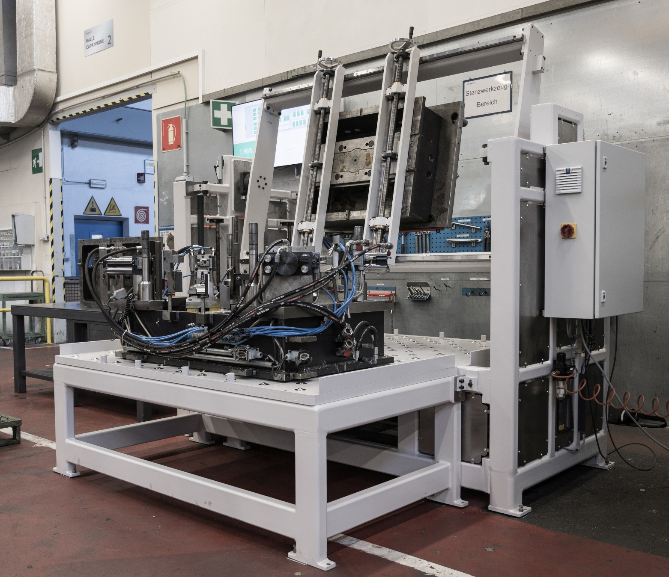
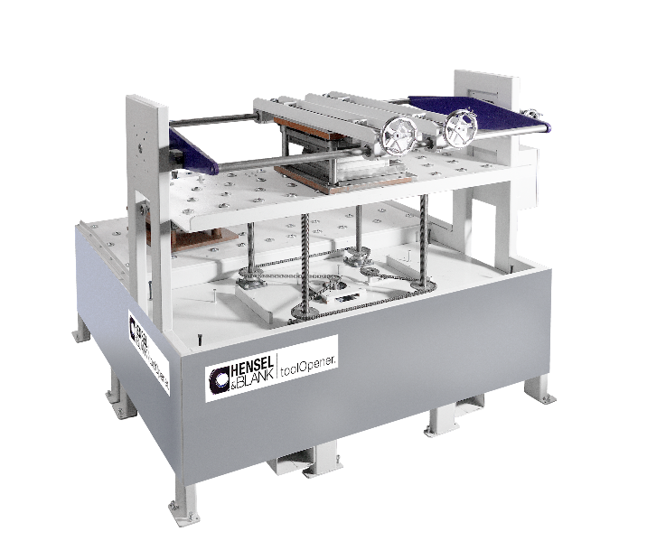

for example the toolOpener tO02.0
toolOpener tO02.0sh
Tool weight: bis 2.00 kg
WZ- dimensions: bis 1.800 x 1.000 x 800 mm
Notes:
Modular concept to accommodate a wide variety of punching, forming and injection molding tools.
Robust drive concepts with the highest precision.
Tools can be easily clamped and joined again after separating the lower and upper part. This opens up completely new possibilities for users and is unique so far.
State-of-the-art control concepts are available in different configurations (Industry 4.0 capable).
The development of these toolOpeners was supported by the central innovation program for medium-sized companies in Europe.

Slide 7
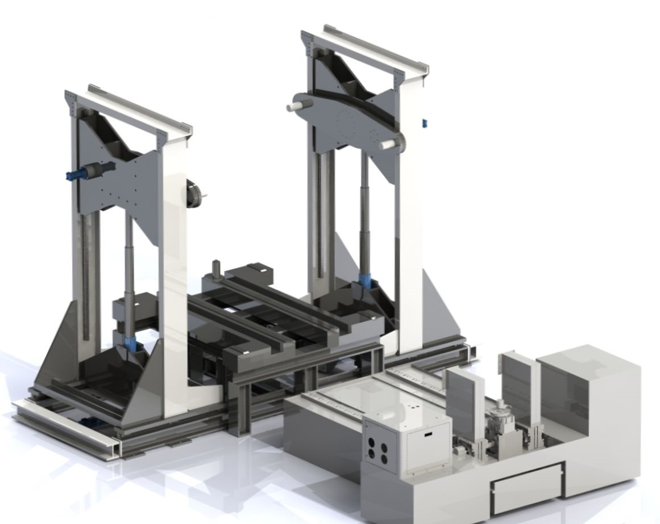
or the toolOpener 40th_green line
with tool- changing trolley
The hydraulic vertical drive is equipped
with energy recovery.
A saving of more than 30% is achieved.
Notes:
Stationary tool handling system for holding different sized punching and forming tools.
There are 3 tool positions defined:
Storage position tool upper part
Transfer and storage position tool lower part
opening position
Loading and unloading possible using crane and tool changing trolleys
The side stands of the lifting unit move symmetrically and are hydraulically driven.
The precision-guided lifting boxes are also driven hydraulically with position control. Energy recovery during the downward movement
The cross-bearing rotating unit is driven by a hydraulic motor and can be freely rotated through 360 °.
Control: Siemens SIMATIC S7 and SIMATIC Touch Panel
Industry 4.0 capable.

Slide 8
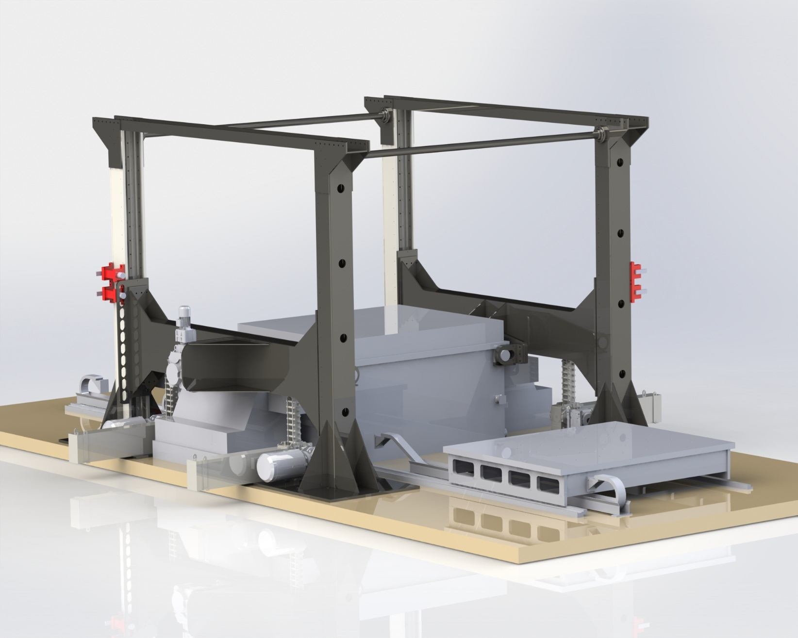
or the toolOpener tO60.0hs
A try-out plant for injection molding
with lifting speed of more than 100 mm/sec
toolOpener tO60.0hs
Tool weight: 60.000 kg
WZ- dimensions: 3.000 x 2.600 x 1.600 mm
Notes:
DISCOVER ADVANTAGES::
Different tool sizes and designs can be opened with one and the same toolOpener.
Tools that have been pulled apart can be removed and loaded and joined at a later point in time.
Access to the upper part of the tool is guaranteed from both sides.
Also particularly suitable as a try-out system for injection molding tools
We offer a practice-oriented and company-specific concept - from the specification to successful commissioning.

Slide 9
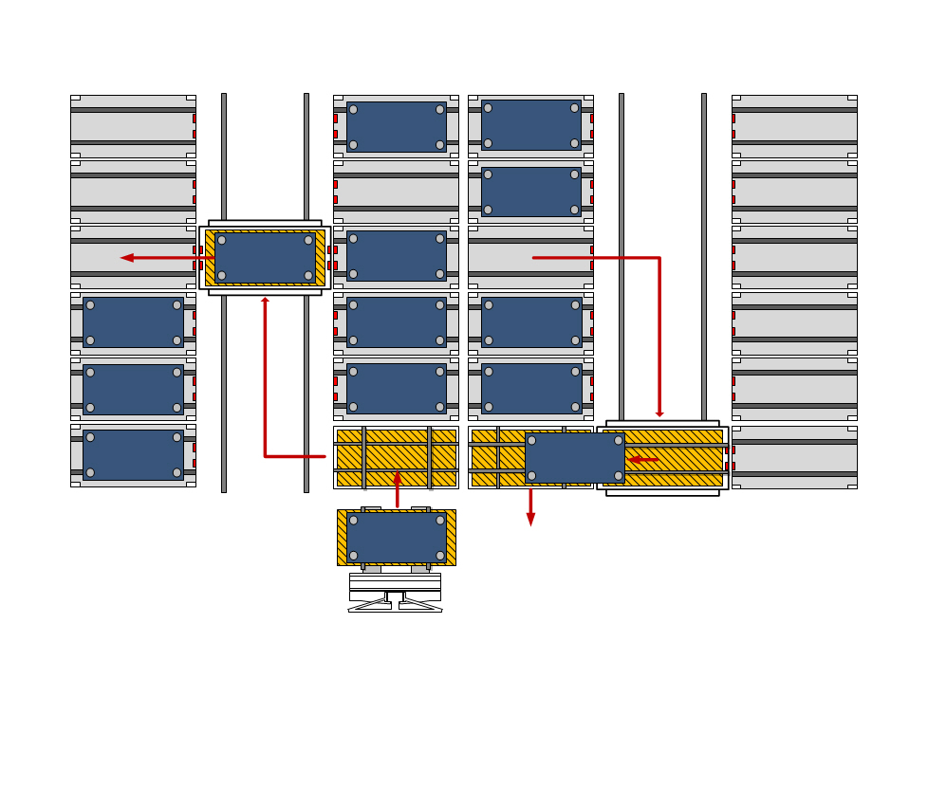
We offer:
individual solutions for the optimization of your stamping shop or tool shop.
tell us your needs and we will work out the optimal solution with you.
Are there any questions from your side ?
toolManager 4 x 18- 10.0To
Notes:
We also offer:
Tool management systems for the storage and provision of punching and forming tools
Proper storage in a confined space
Modularly expandable - one storage module for each tool
The tool change can be automated with the appropriate interfaces to the tool changing carriage and to the press control.
Intelligent storage of the tools (depending on the frequency of use) saves time and resources.
Minimize set-up times in a confined space with the toolManager.

Slide 10
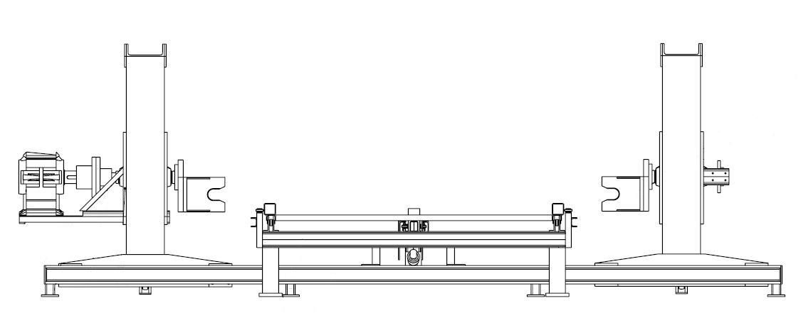
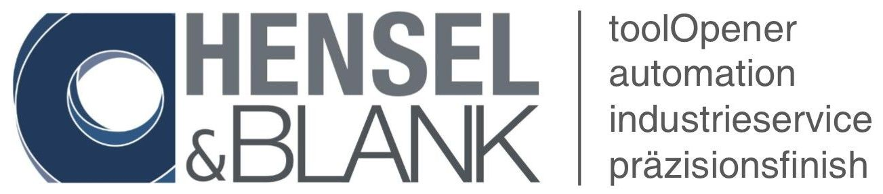
Thank you for your attention
Please contact:Hensel & Blank GmbH; Arrild 16; D- 24407 Oersberg; Fon.: +49(0)4642 3565; info@henselundblank.de; www.henselundblank.de

